Slide 1
Homework – Predicate Logic
Ilie Oana-Andreea
Group 913

Slide 2
Problem statement
05
01
Exercise
Using the given interpretations evaluate the following formulas:

Slide 3
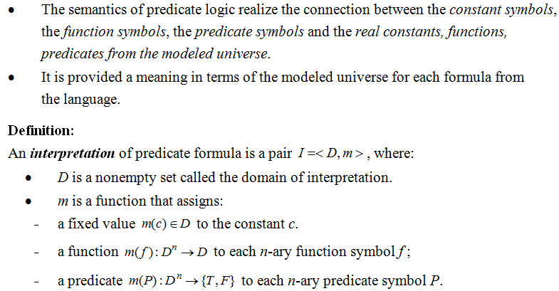
Theoretical results

Slide 4
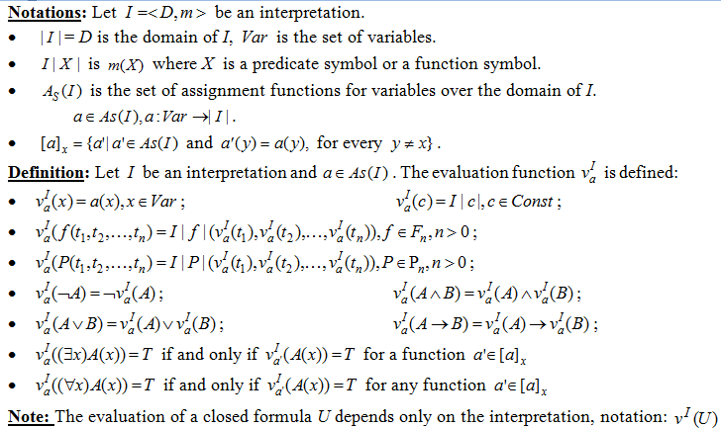
Theoretical results

Slide 5
Theoretical results

Slide 6
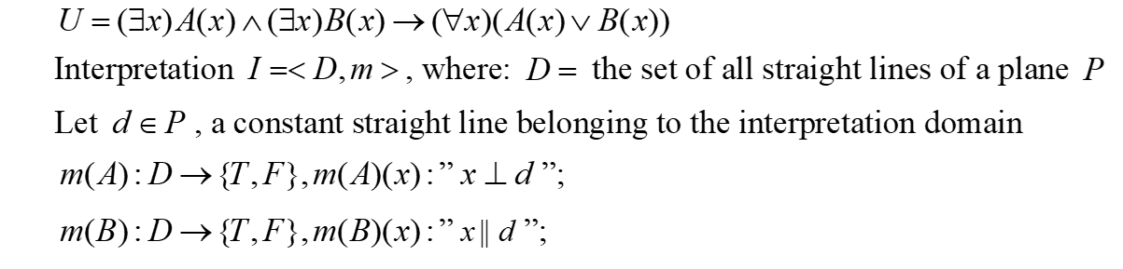
Solving
(∃x)A(x) ∧ (∃x)B(x)
U=
→
(∀x)(A(x) ∨ B(x))
V^{I}(U) =
V^{I}((∃x)A(x) ∧ (∃x)B(x))
→
V^{I}((∀x)(A(x) ∨ B(x)))
V^{I}(U) =
V^{I}((∃x)A(x))
∧
V^{I}((∃x)B(x)))
→
V^{I}((∀x)(A(x) ∨ B(x)))
∧
(∃x) _{x∈D}(x II d)
(∀x) _{x∈D}(x ⊥ d ∨ x II d)
V^{I}(U) =
(∃x) _{x∈D} (x ⊥ d)
→
V^{I}(U) =
T
∧
T
→
F
V^{I}(U) =
T
→
F
V^{I}(U) =
F

Slide 7
Conclusion
V^{I}(U) = F, U is evaluated as False under the interpretation I.
So, I is an anti-model of U.

Slide 8
Problem statement
05
02
Exercise
Using the given interpretations evaluate the following formulas:

Slide 9
Solving
U =
(∃x)(P(x) ∧ Q(x))
(∃x)P(x) ∨ Q(12)
→
V^{I}(U) =
V^{I}(∃x)(P(x) ∧ Q(x))
→
V^{I}(∃x)P(x) ∨ Q(12)
∨
V^{I}(U) =
V^{I}(∃x)(P(x) ∧ Q(x))
→
V^{I}((∃x)P(x))
VI(Q(12))
(∃x) _{x∈N} (x ⋮ 5 ∧ x ⋮ 7)
(∃x) )(x ⋮ 5) _{x∈N}
∨
(12 ⋮ 7)
V^{I}(U) =
→
V^{I}(U) =
T
→
T
F
∨
V^{I}(U) =
T
→
T
V^{I}(U) =
T

Slide 10
Conclusion
V^{I}(U) = T, U is evaluated as True under the interpretation I.
So, I is a model of U.

Slide 11
Problem statement
05
04
Exercise
Using the given interpretations evaluate the following formulas:

Slide 12
Solving
(∀x)(A(x) → B(x))
∧
U =
(∃x)(B(x) ∧ ¬A(x))
V^{I} (U) =
V^{I}(∀x)(A(x) → B(x))
∧
V^{I}(∃x)(B(x) ∧ ¬A(x))
V^{I} (U) =
(∀ x)_{x∈N} (x is prime → x is an odd number)
∧
(∃x) _{x∈N}(x is an odd number ∧ x is not prime)
F
V^{I} (U) =
∧
T
V^{I} (U) =
F

Slide 13
Conclusion
V^{I}(U) = F, U is evaluated as False under the interpretation I.
So, I is an anti-model of U.

Slide 14
Problem statement
05
06
Exercise
Using the given interpretations evaluate the following formulas:

Slide 15
Solving
U =
→
((∃x)A(x) → (∀x)B(x))
((∀x)A(x) → (∃x)B(x))
V^{I}(U) =
V^{I} ((∀x)A(x) → (∃x)B(x))
→
V^{I}((∃x)A(x) → (∀x)B(x))
V^{I}(U) =
→
V^{I} ((∃x)A(x))
→
V^{I} ((∀x)(A(x))
V^{I} ((∃x)B(x))
→
V^{I} ((∀x)B(x))
V^{I}(U) =
→
(∀x) (the person x lives in a city)
(∃x)(the person x has
a job)
→
(∃x)(the person x lives in a city)
→
(∀x)(the person
x has a job)
→
→
→
V^{I}(U) =
T
T
F
F
→
→
V^{I}(U) =
T
F
T
→
V^{I}(U) =
F
T
V^{I}(U) =
T

Slide 16
Conclusion
V^{I}(U) = F, U is evaluated as False under the interpretation I.
So, I is an anti-model of U.

Slide 17
Problem statement
05
07
Exercise
Using the given interpretations evaluate the following formulas:

Slide 18
Solving
U =
(∃x)A(x) ∧ (∃x)B(x)
→
(∀ x)(A(x) ∧ B(x))
→
V^{I} ((∀ x)(A(x) ∧ B(x)))
V^{I}(U) =
V^{I} ((∃x)A(x) ∧ (∃x)B(x))
V^{I}(U) =
V^{I} ((∃x)A(x))
∧
V^{I} ((∃x)(B(x)))
→
V^{I} ((∀ x)(A(x) ∧ B(x)))
V^{I}(U) =
(∃x)_{x∈N} (x is a perfect square)
∧
(∃x)_{x∈N} (x is divisible
by 10)
→
(∀ x)(x is a perfect square ∧ x is divisible by 10)
V^{I}(U) =
T
∧
T
→
F
V^{I}(U) =
T
→
F
V^{I}(U) =
F

Slide 19
Conclusion
V^{I}(U) = F, U is evaluated as False under the interpretation I.
So, I is an anti-model of U.

Slide 20
Problem statement
05
03
Exercise
Using the given interpretations evaluate the following formulas:

Slide 21
Solving
U = (∀x)(P(x) ∧ Q(x)) → P(sq(x)) ∧ Q(prod(x,5)))
V^{I}(U) = V^{I} ((∀x)(P(x) ∧ Q(x)) → P(sq(x)) ∧ Q(prod(x,5))))
V^{I}(U) = (∀x) _{x∈Z}(x is even ∧ x<0 → sq(x) is even ∧ prod(x,5)<0)
V^{I}(U) = F

Slide 22
Conclusion
V^{I}(U) = F, U is evaluated as False under the interpretation I.
SO, I is an anti-model of U.

Slide 23
Problem statement
05
05
Exercise
Using the given interpretations evaluate the following formulas:

Slide 24
Solving
U = (∀x) (∀y)(A(x) ∧ A(y) → ¬A(sum(x,y)) ∧ (∀z)A(prod(y,z)))
V^{I}(U) = V^{I} ((∀x) (∀y)(A(x) ∧ A(y) → ¬A(sum(x,y)) ∧ (∀z)A(prod(y,z))))
V^{I}(U) = (∀x) _{x∈N} (∀y) _{y∈N}(x is an odd number ∧ y is an odd number →sum(x,y) is not an odd number ∧ (∀z)(prod(y,z) is an odd number))
V^{I}(U) = F

Slide 25
Conclusion
V^{I}(U) = T, U is evaluated as True under the interpretation I.
So, I is a model of U.

Slide 26
Thank you!

